Slide 1
Lead Scoring Case Study
Presented by
Rohan Pujari & Rishita Sinha

Slide 2



Problem Statement
An education company named X Education sells online courses to industry professionals
Now, although X Education gets a lot of leads, its lead conversion rate is just 30%
The company wants to increase the conversion it to 80%

Slide 3
Goals
Build a logistic regression model to score between 0 to100 to each of the leads which can be used by the company to identify potential leads.
A higher score would mean that the lead is hot and is more likely to convert whereas lower score would mean that the lead is cold and most it will not convert.

Slide 4
What we did with the data
Import and read the data
Data cleaning
Exploratory Data Analysis
RFE
Model Building – Logistic Regression
Model Evaluation metrics
Prediction on Test data
Conclusion and Recomdentation

Slide 5
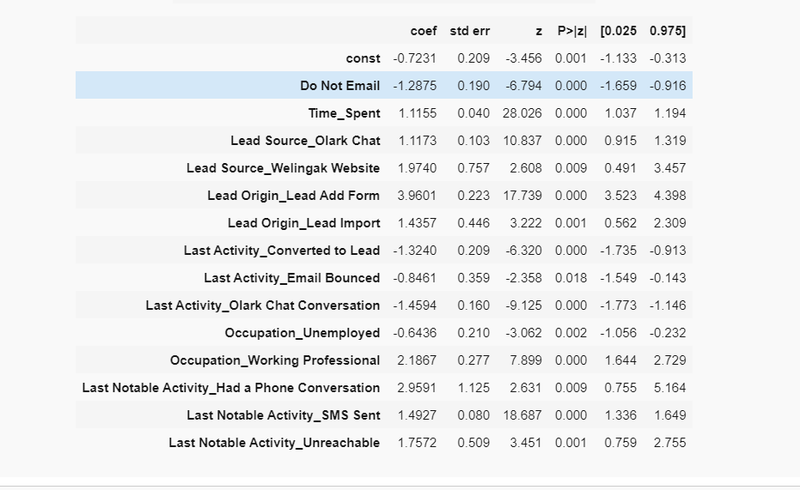
Variables we found that are impacting the conversion of leads

Slide 6
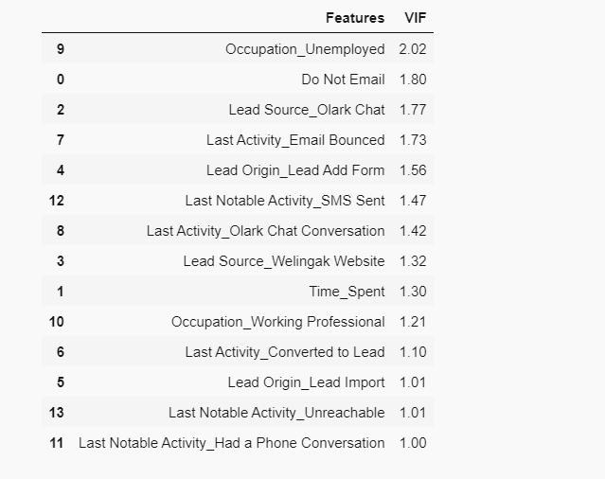
Variance Inflation Factor

Slide 7
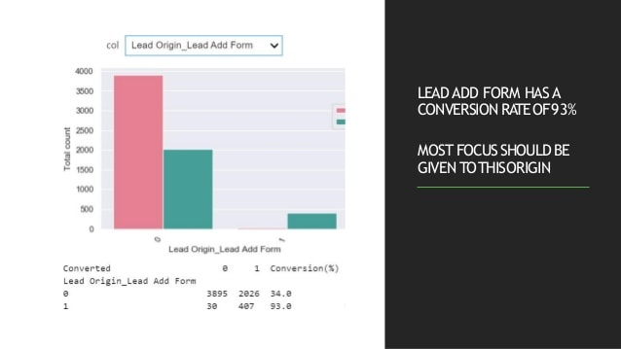
LeadOrigin_LeadAddForm

Slide 8
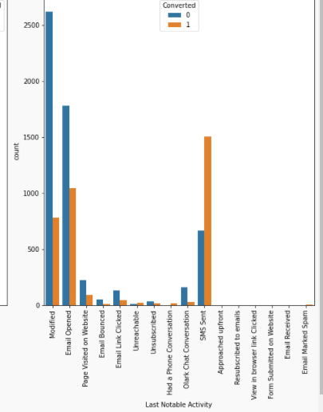
Last notable activity
All these last notable
activity of the users
should be focused more.
SMS sent , emails opened
And modified have
highest conversion rate.

Slide 9
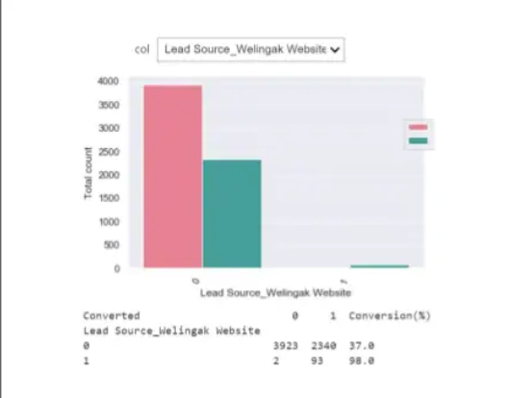
Lead source
People visiting this website have a high conversion rate around 98%.

Slide 10
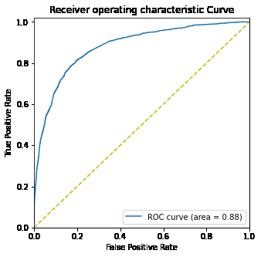
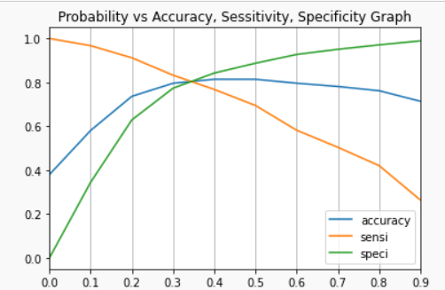
Model Evaluation Metric

Slide 11
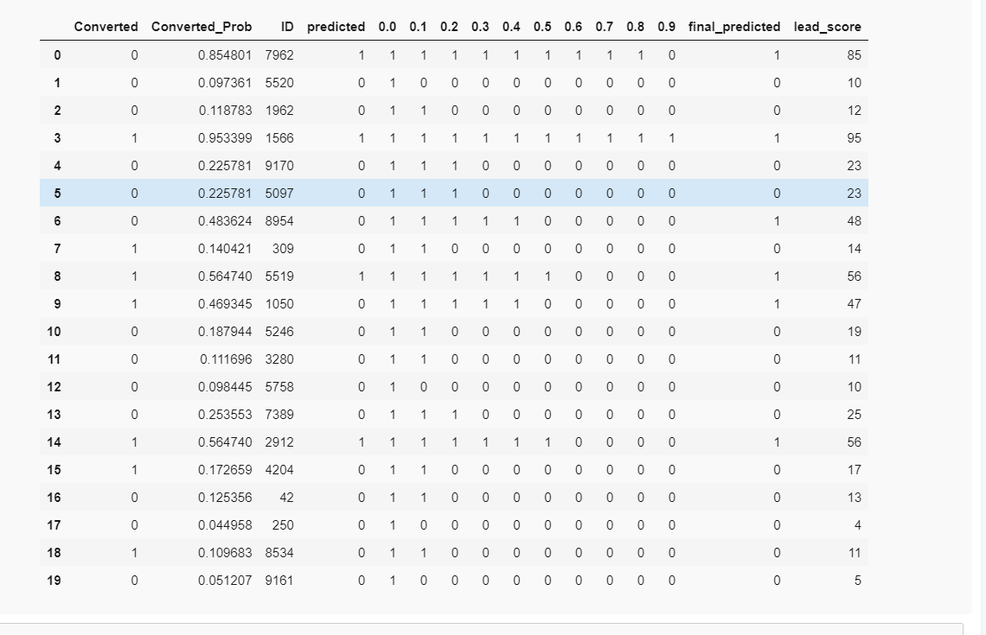
Lead prediction basis the probability set by the model

Slide 12
Thank you

